Slide 1

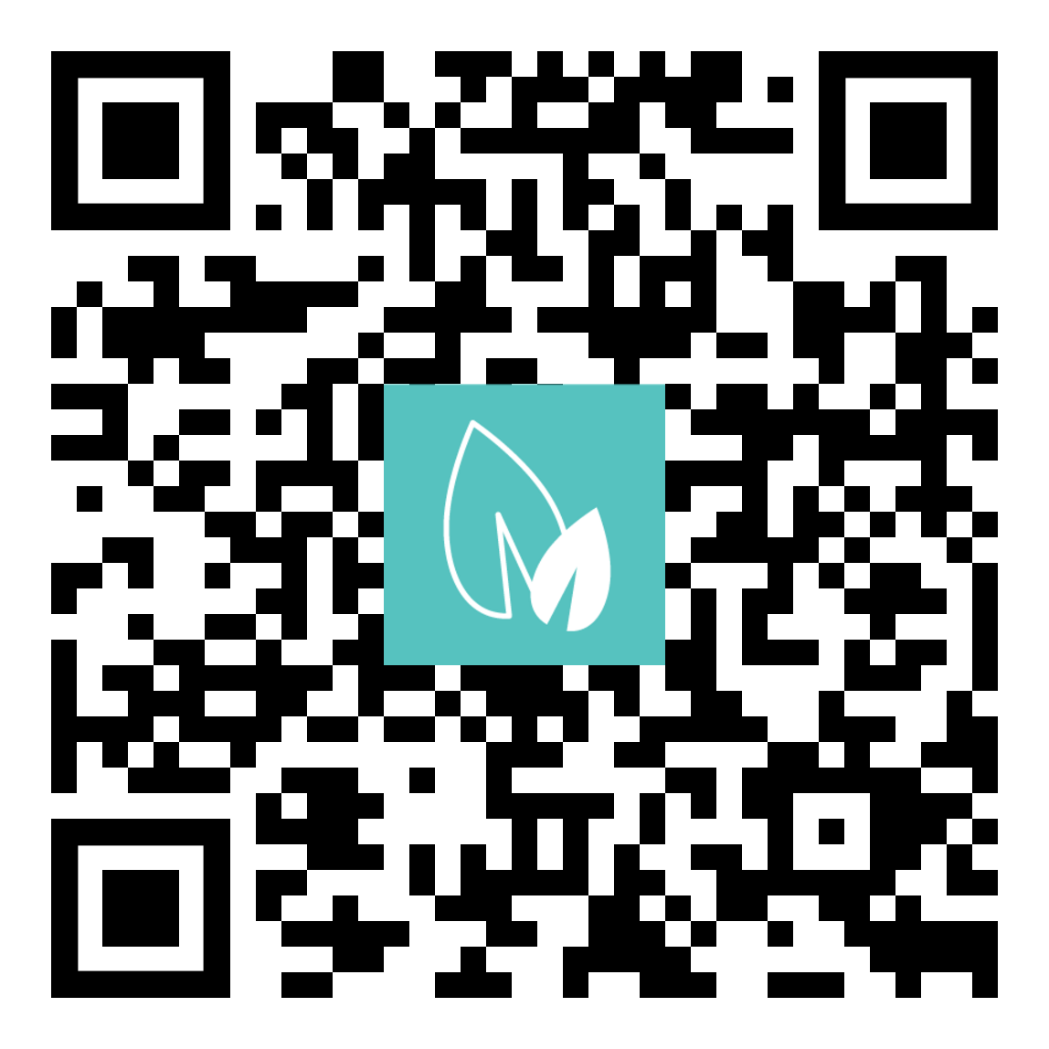
Join us at Michigan’s largest conference for environmental professionals.
Choose from over 70 concurrent technical sessions
Check out services at our huge exhibitor showcase
Get one-on-one assistance from EGLE staff
Network with hundreds of environmental professionals
Earn continuing education hours for professional development

