Slide 1

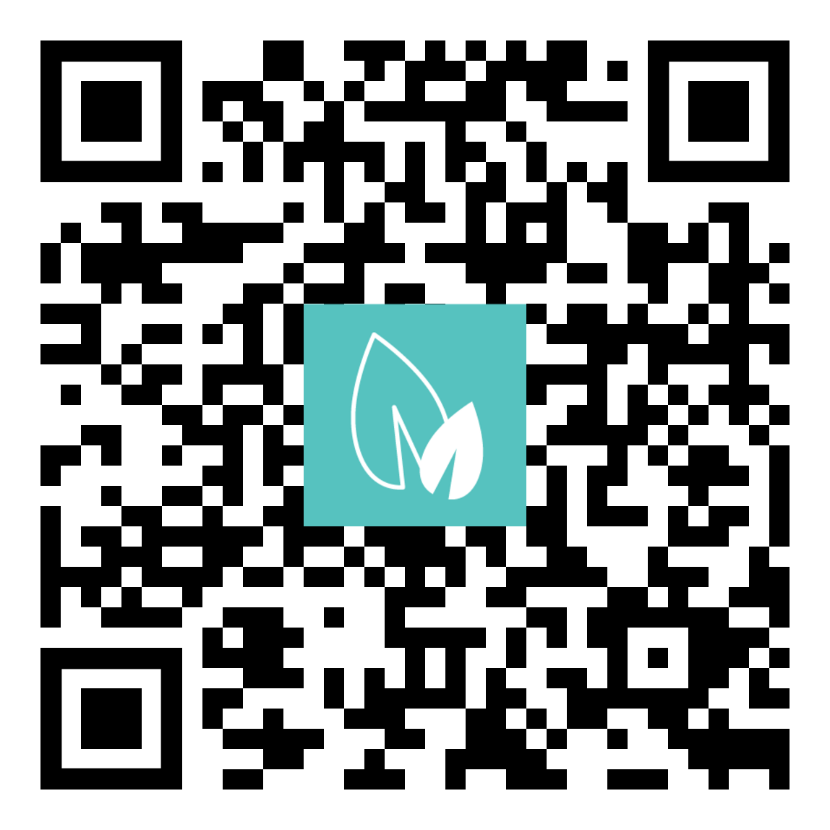
June 9-10, 2026
Lansing Center, Lansing MI
70+ concurrent technical sessions
Huge Exhibitor Showcase
One-on-one assistance from EGLE staff
Network with hundreds of environmental professionals
Michigan.gov/MECC

